Slide 1
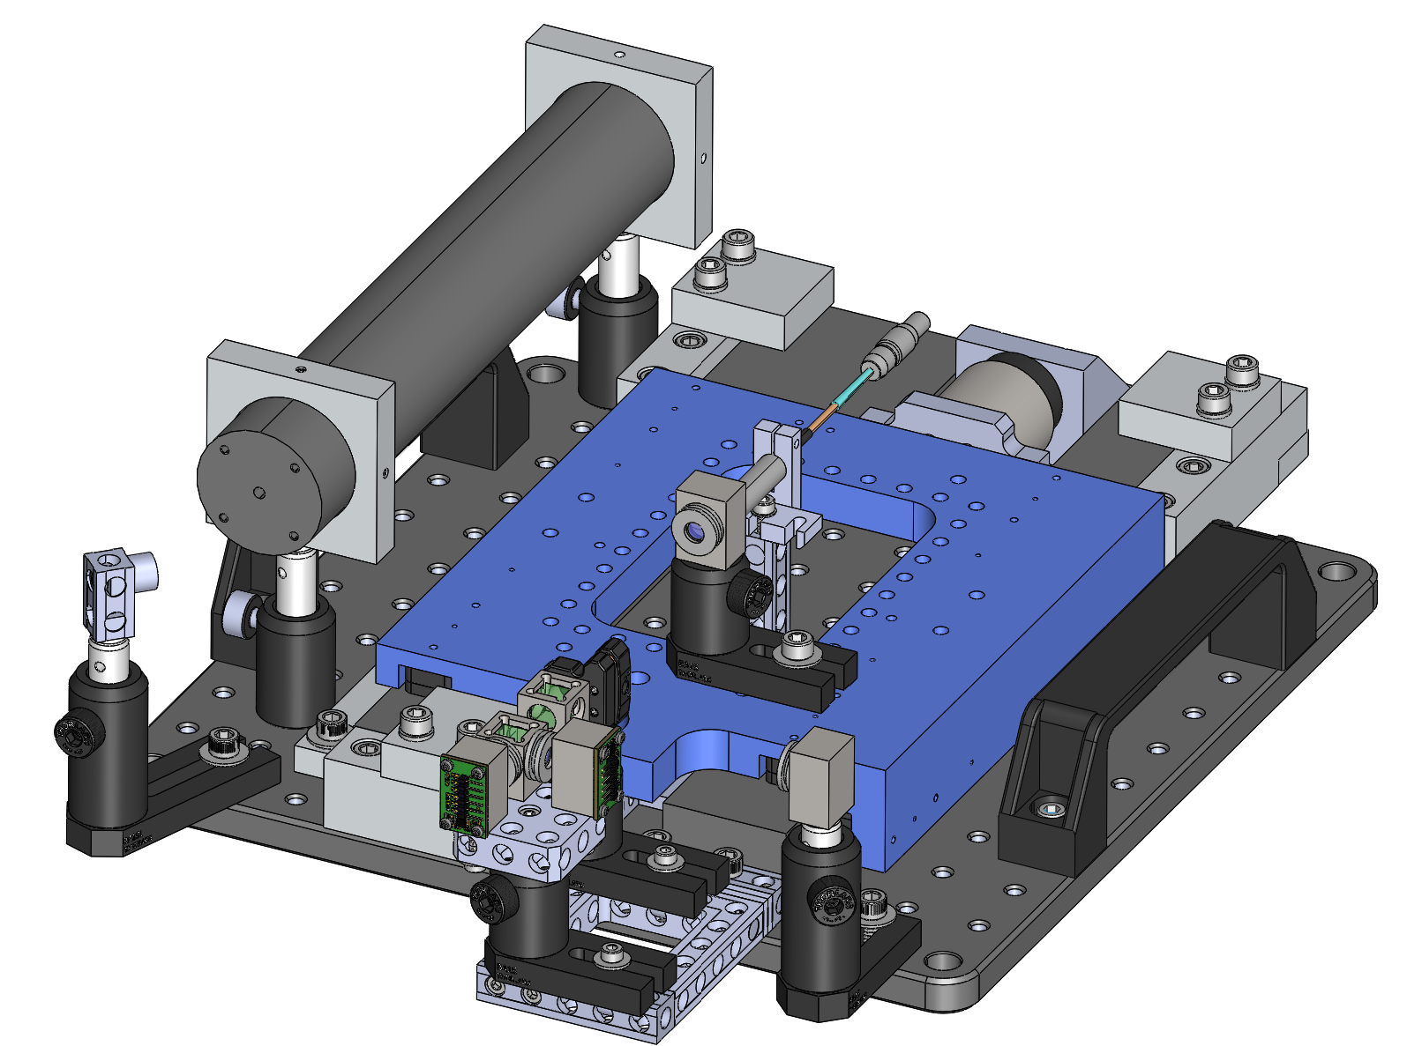
2023- Boston: Interferometric nanopositioner
He-Ne laser
Voice coil actuator
Turning mirror
Air-bearing stage
Capacitance probe
Mobile corner cube
Detector bench
Fixed corner cube

Slide 2





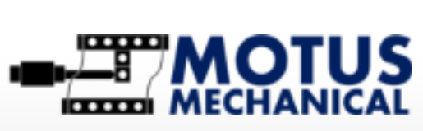






2023 Sponsors
VDL Enabling Technologies Group
Physik Instrumente gmbh
RepairFAQ.org

Slide 3



Equipment support
Machining support
Capacitance probe
He-Ne laser
Voice coil
Air-bearing stage
Mechblocks
linescale

Slide 4
Interferometer layout

Slide 5
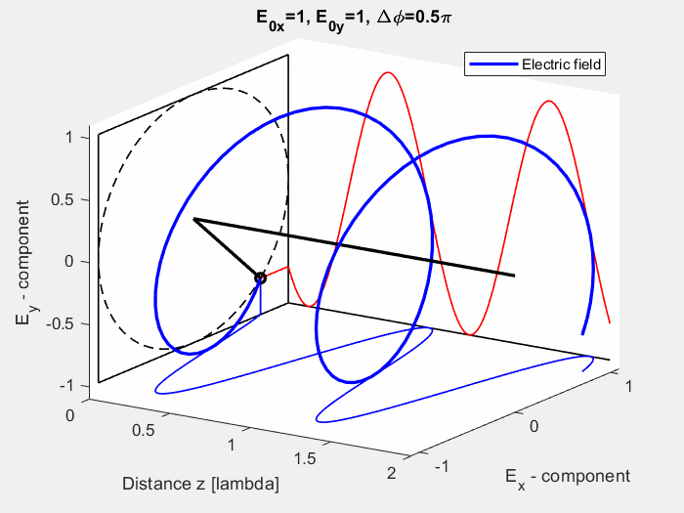
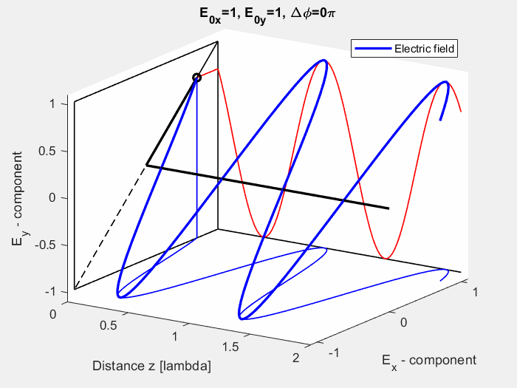
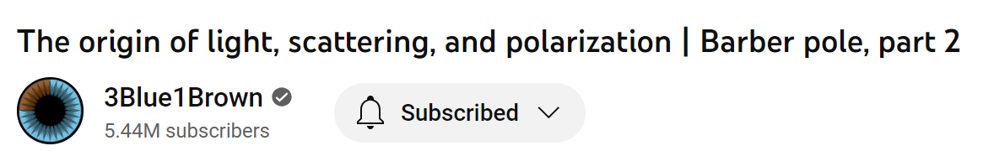
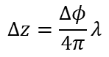
Linearly polarized laser
(X and Y components have equal magnitude (intensity) and zero phase offset)
$$Δz$$
Corner cube
Laser is rotated in z such that it‘s linear polarization state is 45° (as shown in left) before entering the polarizing beam splitter (PBS)
S
QWP
P
y
PBS
P
QWP
x
z
Corner cube
S
https://commons.wikimedia.org/wiki/File:Circular_LH_polarization.gif
https://commons.wikimedia.org/wiki/File:Linearly_polarized_wave_-_45_degrees.gif
P
S
No interference occur here because the reflected waves oscillate in orthogonal planes
CP2
50:50 beam splitter
P
S
Photodiode 2
P
S
QWP
Linear Polarizer
Circular Polarizer, CP1
QWP
When the rotation angle of the Circular Polarizers differ by 45° and any of the corner cubes move,
FRINGE
$$Δz=\frac{Δφ}{4π}λ$$
Circularized beams interfere
Photodiode 1
Linear Polarizer
Intensity
Photodiode 1
Photodiode 2
Sam Goldwasser to share basics of Homodyne interferometry shortly
Time

Slide 6
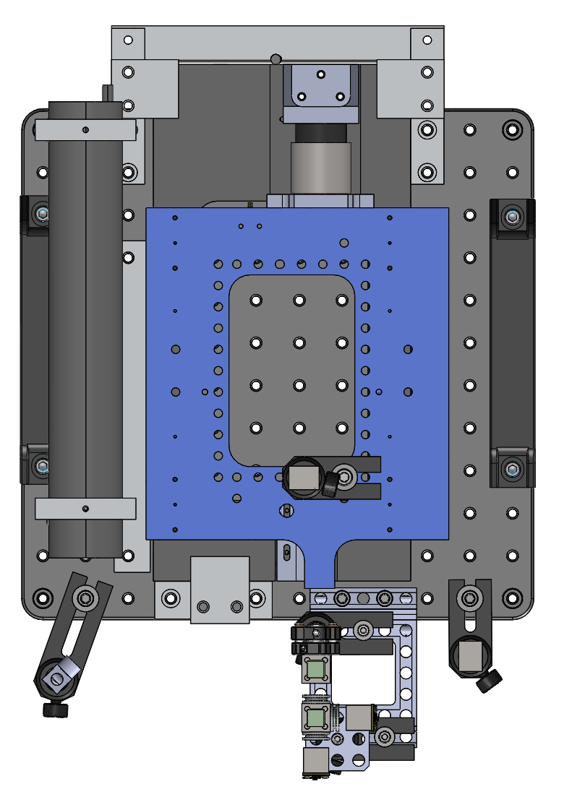
Assemble and align
the interferometer with the preassembled stage
He-Ne laser
Mobile corner cube
Turning mirror
Fixed corner cube
Detector bench

Slide 7
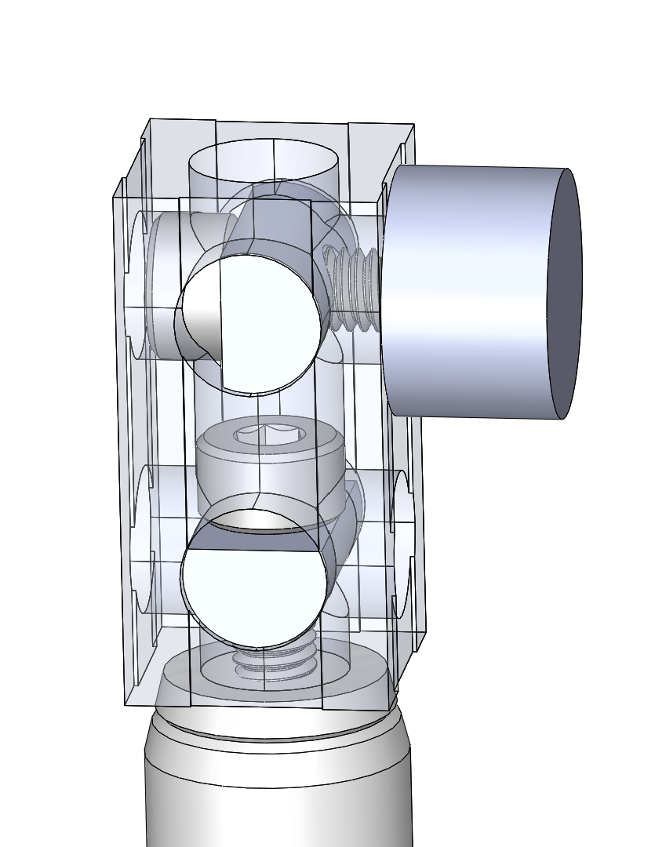

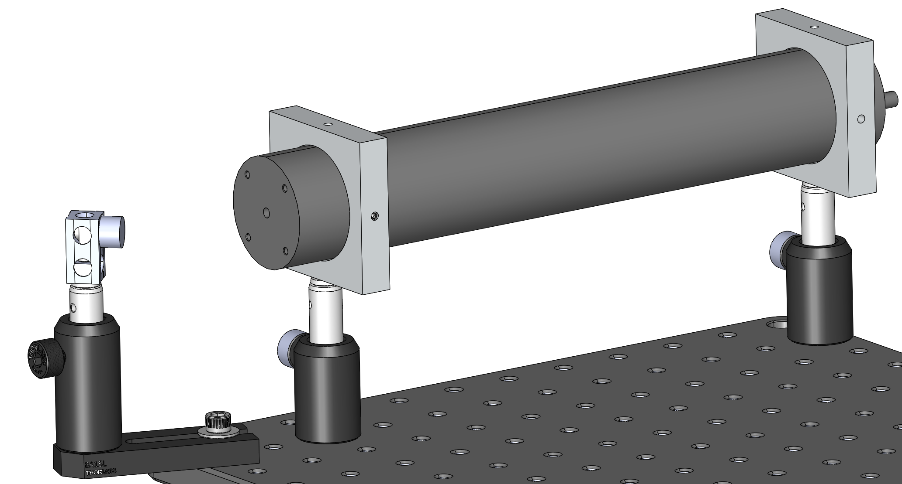
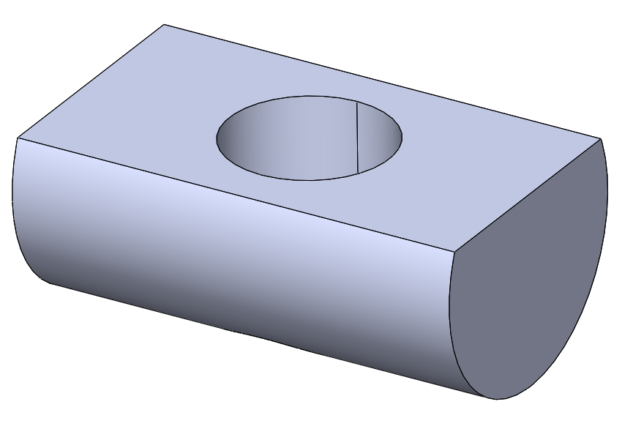
Laser mounting & steering
Copper coated turning mirror
M4 L10 screw
M4 half round washers
M4 L12 screw
Laser
TR50 optical posts (2x)
2x1 Mechblock
Laser mounts (2x) with M4 setscrews
PH1.5 optical post holders (2x) attached to the optical breadboard using ¼-20 setscrews
optical post (TR50)
optical post holder (PH50)
¼-20 L0.75 in. bolt and washer
Base clamp (BA1SL )

Slide 8
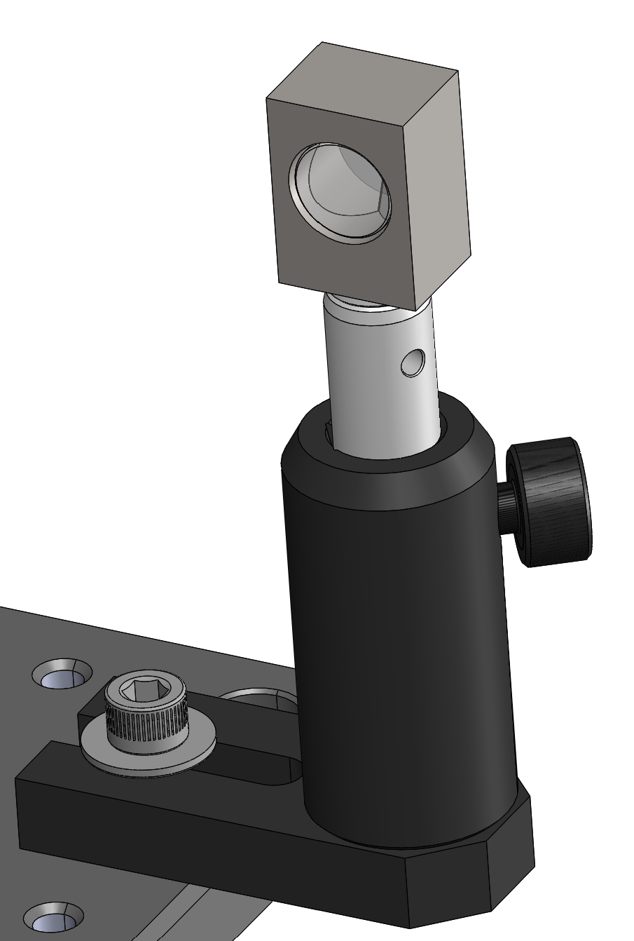
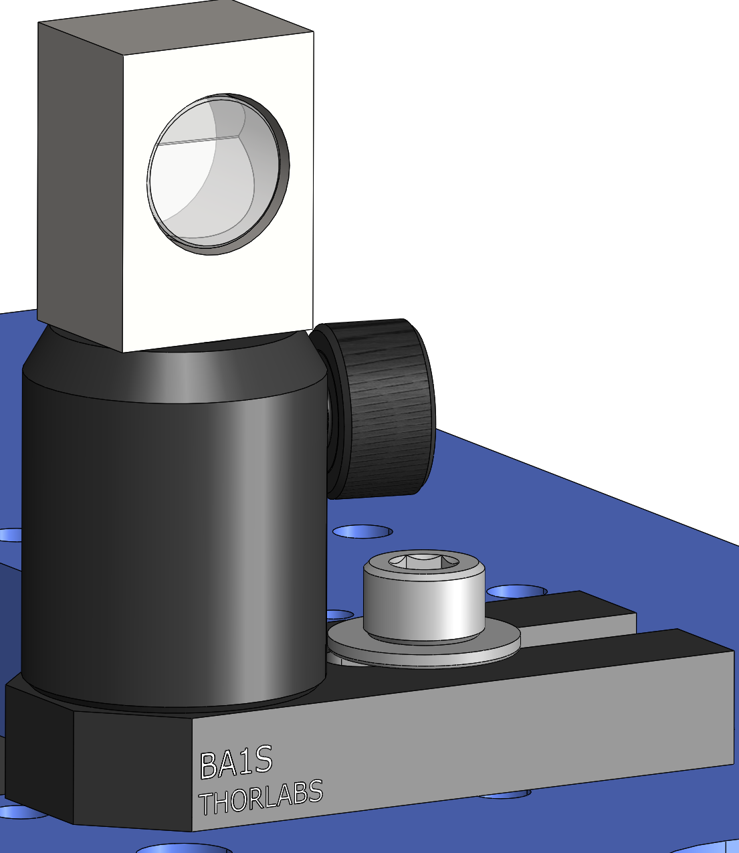
Corner cubes
Fixed corner cube
Moving corner cube
optical post (TR50) for vertical adjustment
optical post holder (PH50)
optical post holder (PH30)
optical post (TR20) inside
¼-20 L0.75 in. bolt and washer
M6 L16 bolt and washer
Use base clamp (BA1S ) for lateral adjustment
¼ wave plates will need be attached on the face of the corner cubes

Slide 9
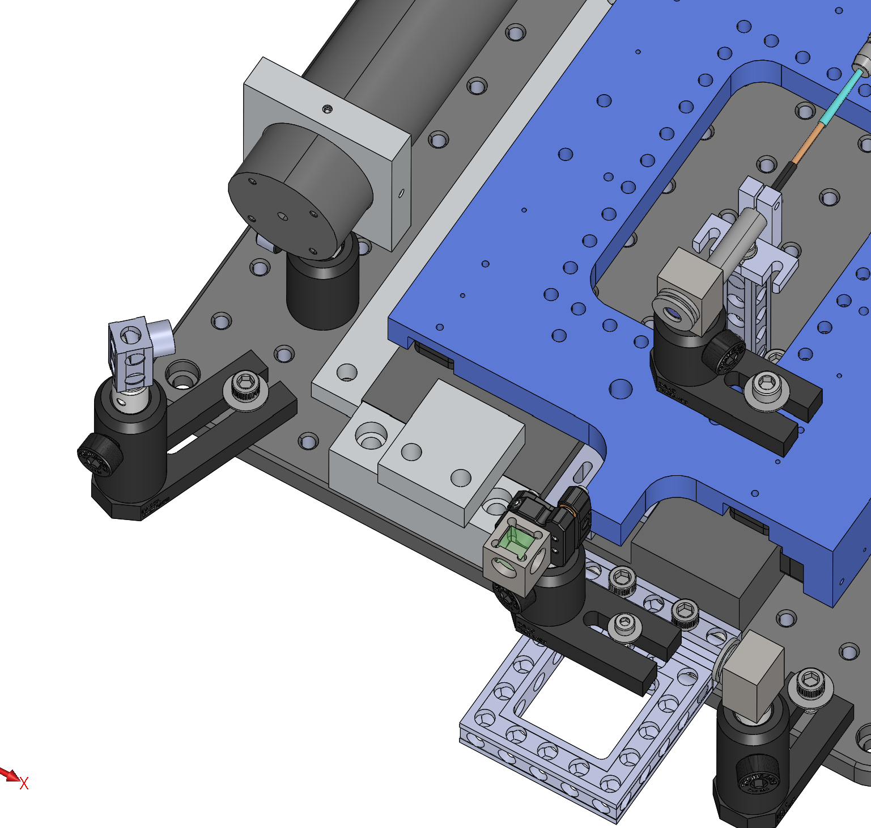
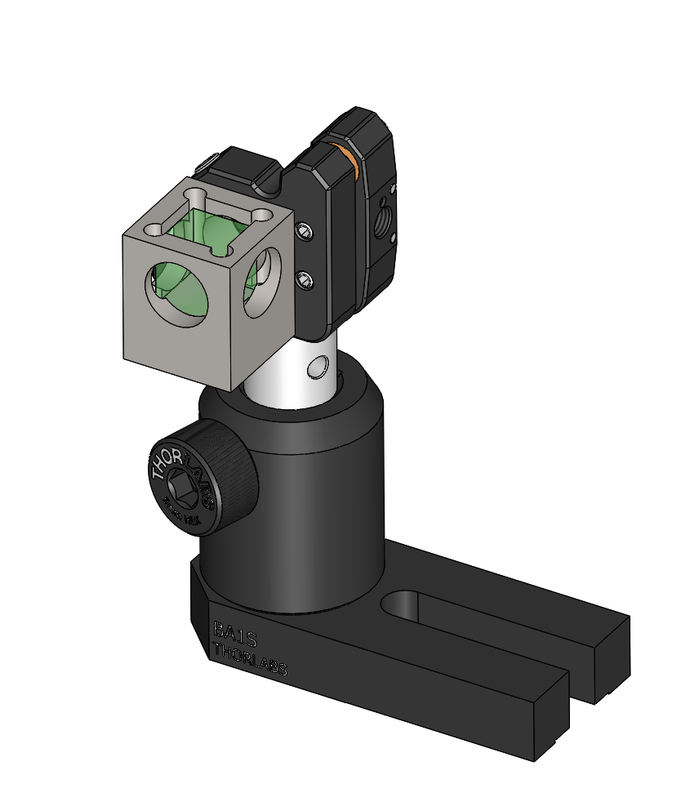
Polarized beam splitter on a tip tilt mount

Slide 10
If stage motion axis is not inline with the laser beam axis
Moving carriage
This will cause the entry and exit beams on the moving corner cube to translate (‘shear’)
Fixed guideway
Moving corner cube
Moving corner cube
Therefore, the exit beam will not interfere with the beam from the fixed corner cube
Laser source
Fixed corner cube
Laser source
beamsplitter
Fixed corner cube
beamsplitter
Detector
Detector

Slide 11
One can rotate the stage, or the whole intererometer asssembly
Or simply rotate the beamsplitter
Therefore, the tip tilt adjustment
Moving corner cube
Moving corner cube
Laser source
beamsplitter
Fixed corner cube
Laser source
beamsplitter
Fixed corner cube
Detector
Detector

Slide 12
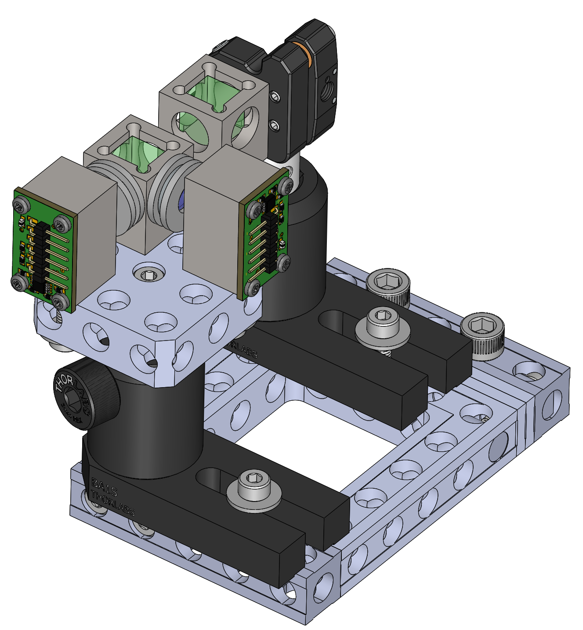
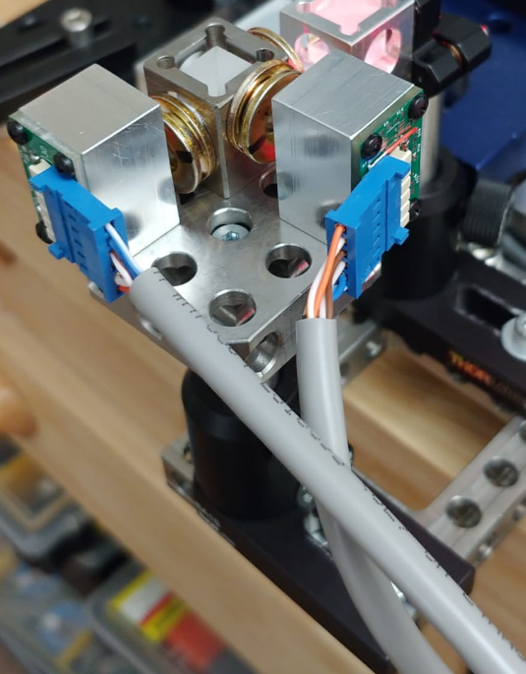
Detector bench
From mobile corner cube
Polarized beam splitter
Tip-tilt kinematic adjuster (KM05/M)
50:50 beam splitter
Circular Polarizer 1
Photodetector 1
From fixed corner cube
¼-20 screws to mount to the optical breadboard
Circular Polarizer 2
Photodetector 2
Note that photodetector PCBs are mounted so that the cables come from the same side
Optical post (TR50) and holder (PH30)

Slide 13

Identifying magnetically held polarization optics
¼ wave plates – yellow chrome plated steel washer, 6 mm aperture
Circular polarizers – Zinc plated steel washer, 6 mm aperture
Linear polarizers – Zinc plated steel washer, 3 mm aperture
https://www.youtube.com/watch?v=qwOXKlQ_gFo&t=296s

Slide 14
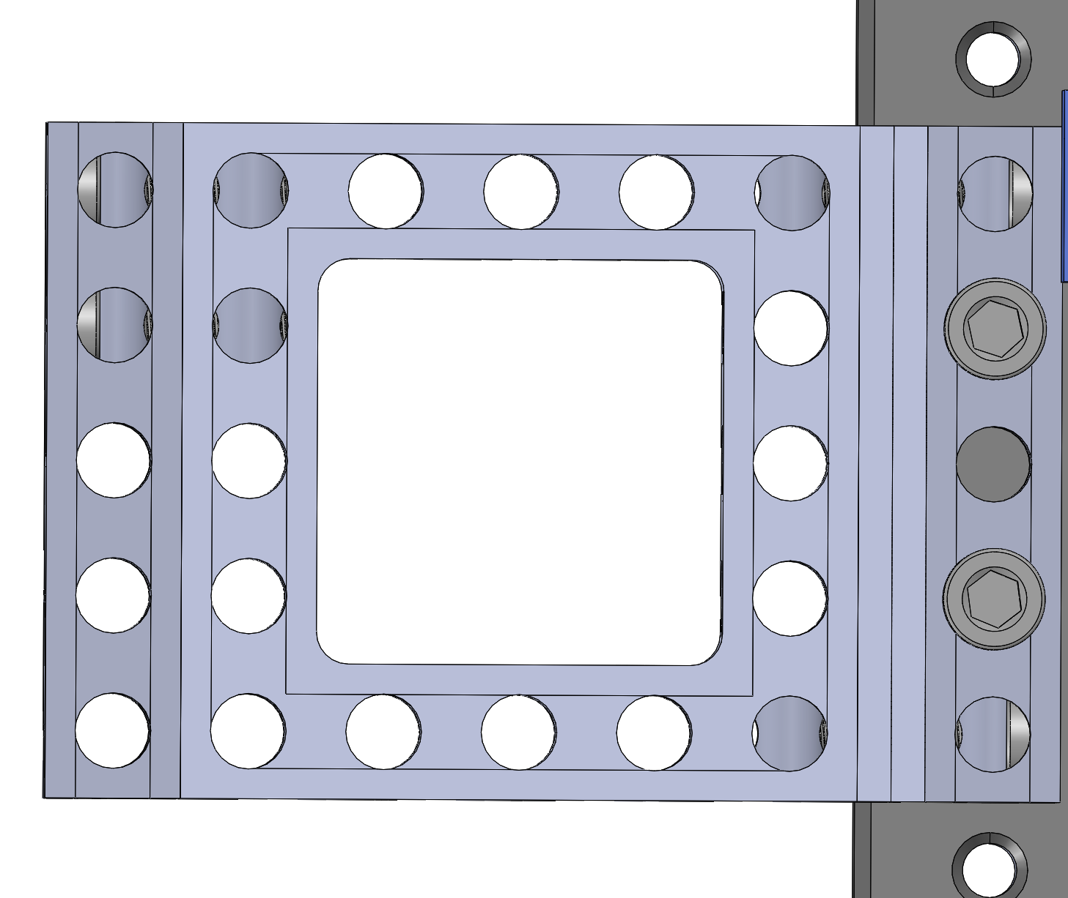
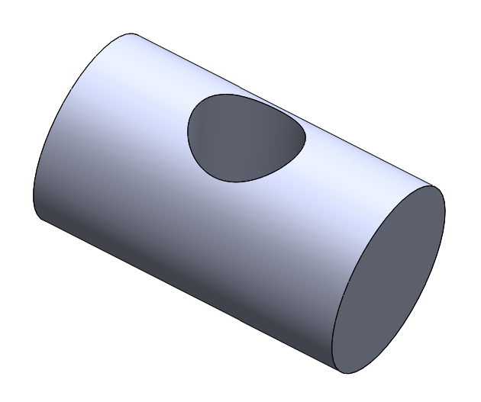
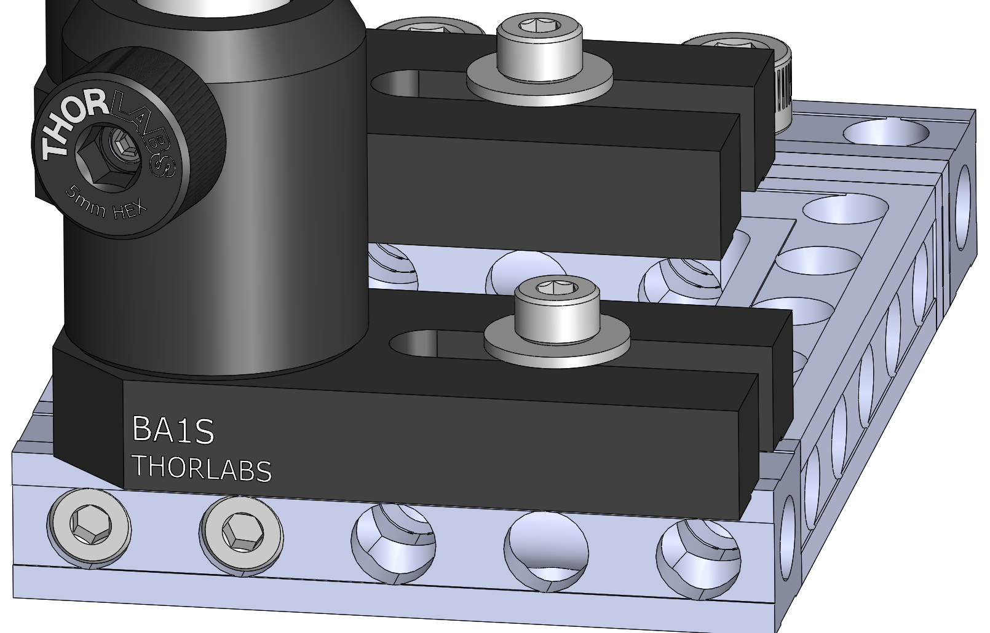
¼-20 L0.75 in.
M4 half round washer
M4 half round washer
Two 5x0.25 Mechblocks
M4 threaded inserts
M4 threaded inserts
5x5 Mechblock
Loosen the M4 L20 screws to adjust the beam splitter base clamps laterally
M4 threaded inserts
Base clamp
M4 half round washer
5x1 Mechblock
M4 threaded inserts
Optical post holder (PH30)
Base clamp

Slide 15
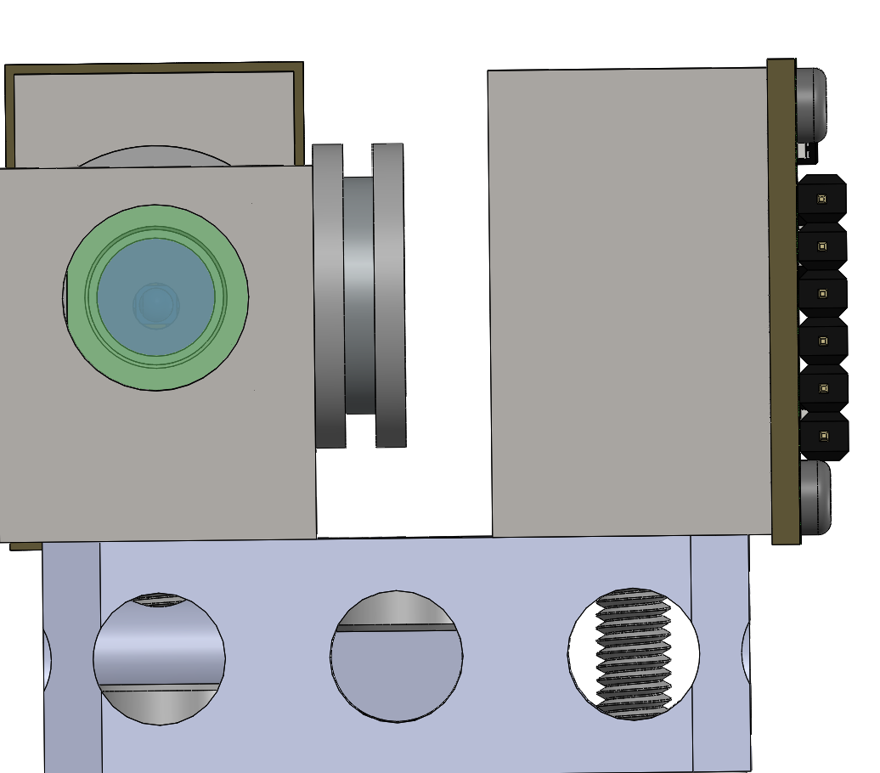
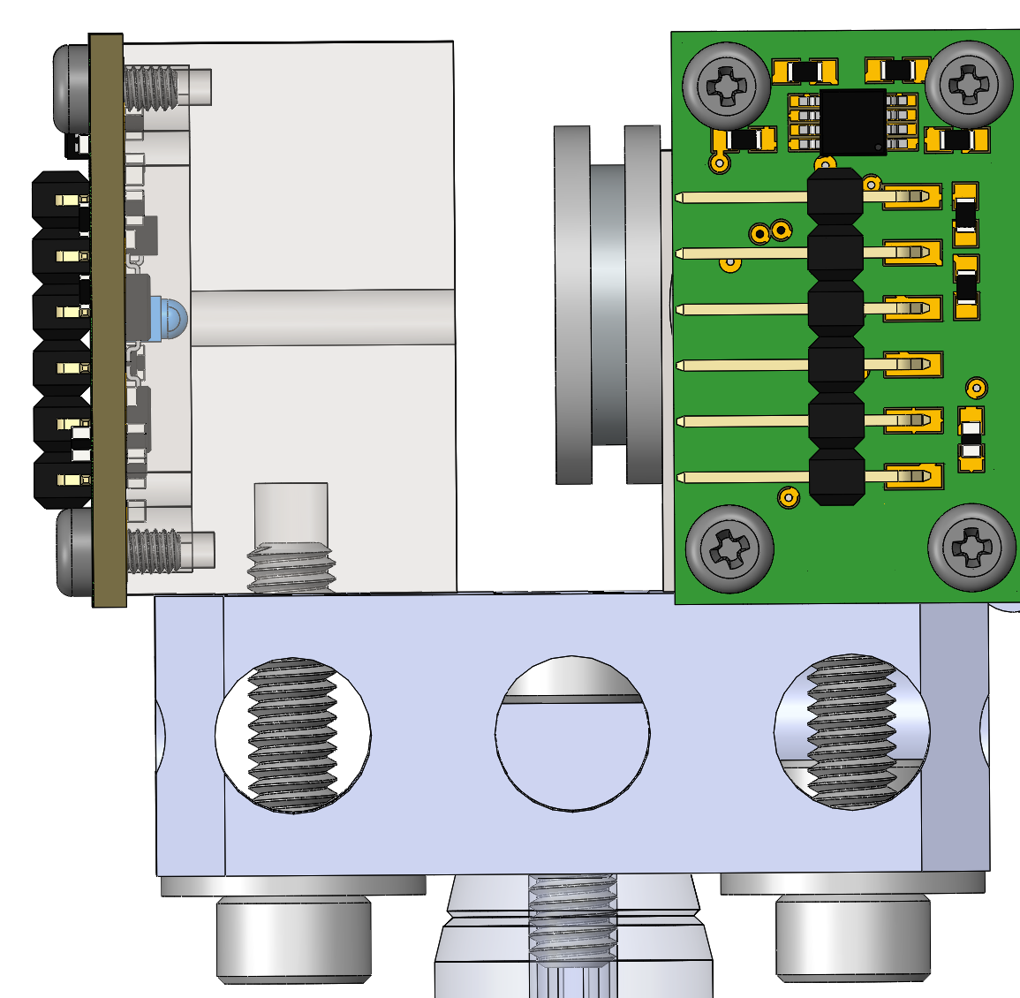
M4 half round washer
50:50 beam splitter
M4 half round washer
M4 L10 screw
M4 L12 screw
M4 L16 screw
Loosen the M4 L16 screws to adjust the photodetectors laterally

Slide 16
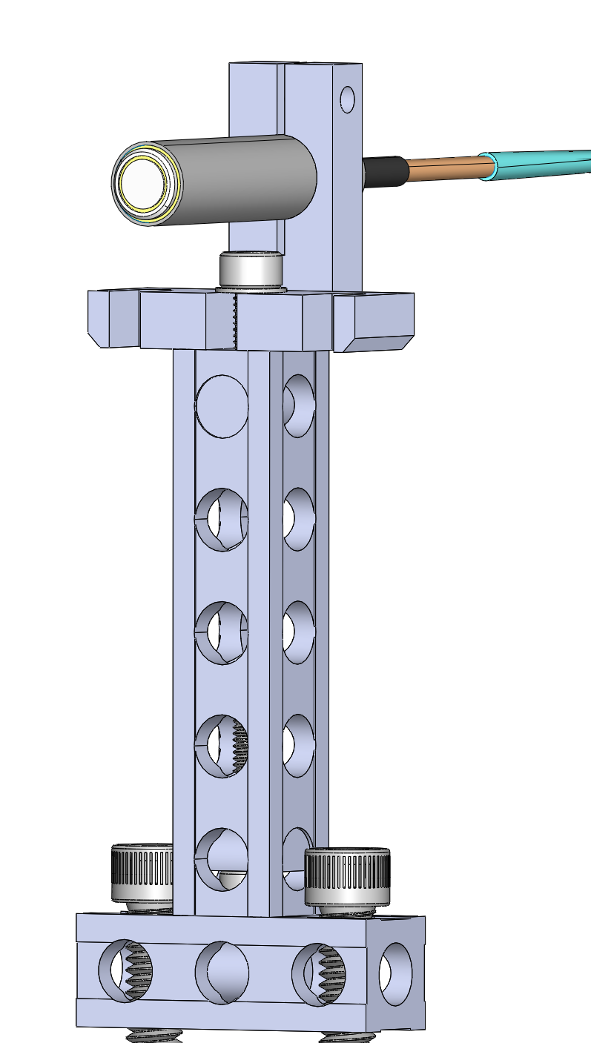
Capacitance probe holder
probe
Clamp
C11-1.5-9.5-N
M4 L12 screw and washer
M4 threaded insert
M4 half round washer
Two ¼-20 screws to mount to the optical breadboard
M4 L12 screw

Slide 17
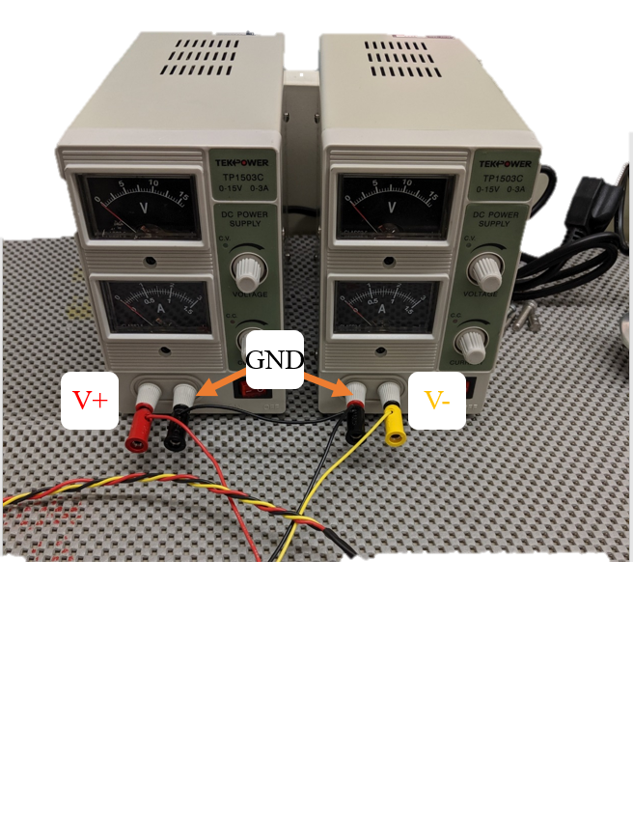
Power supply for the 16-bit DAQ -voice coil amplifier box
GND
+15 V
-15 V

Slide 18
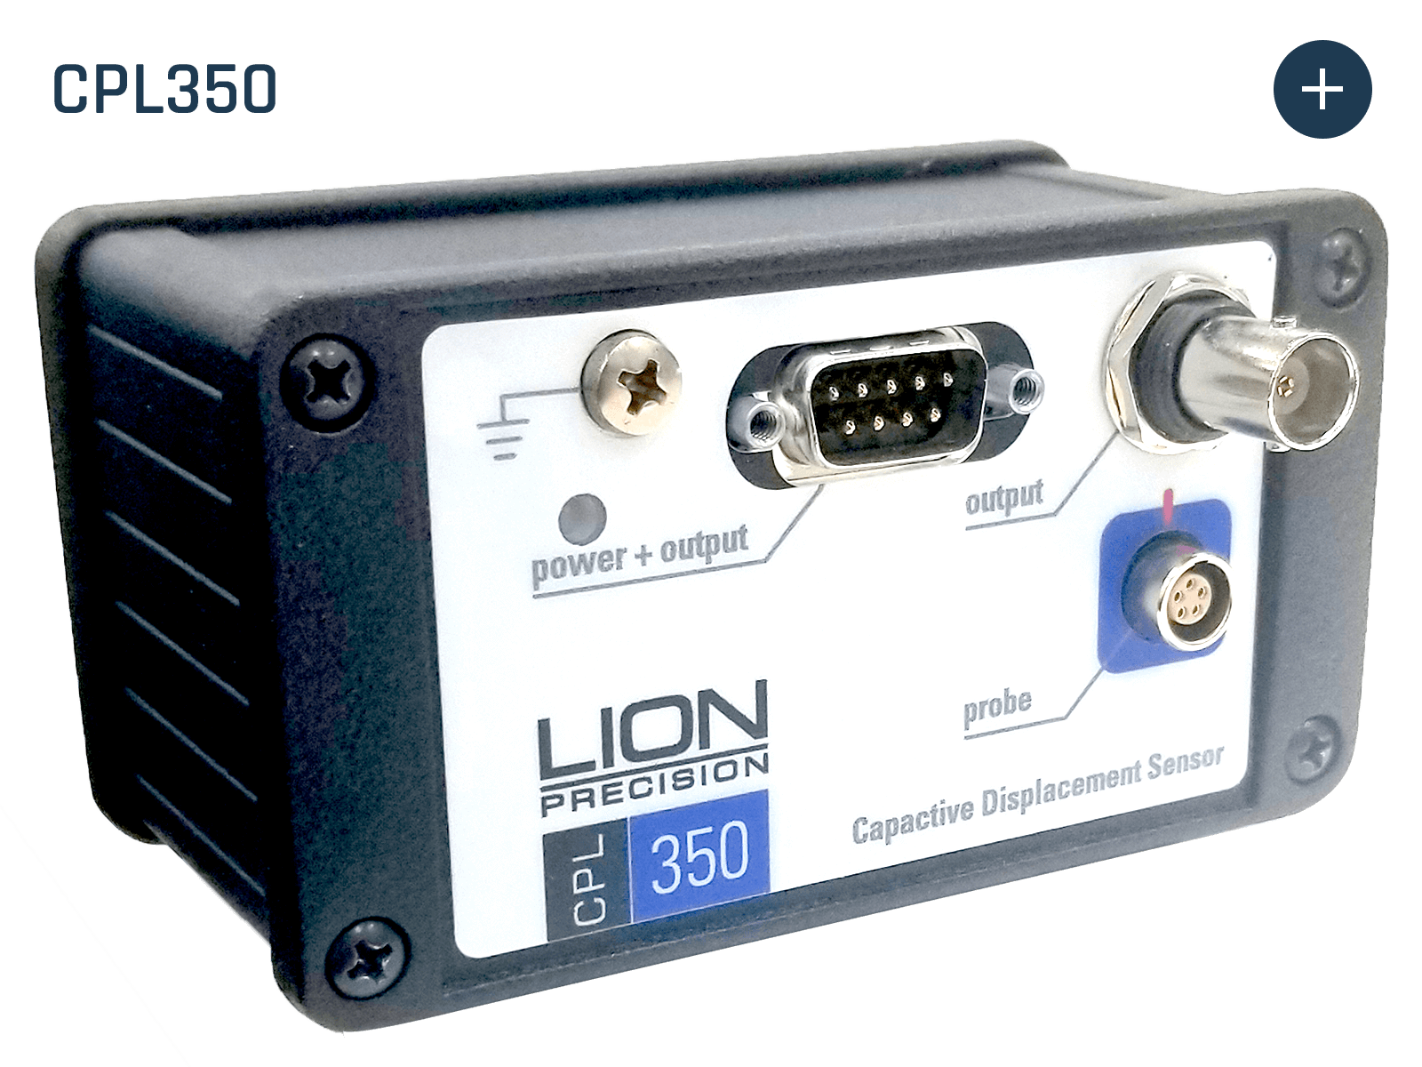
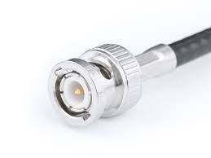
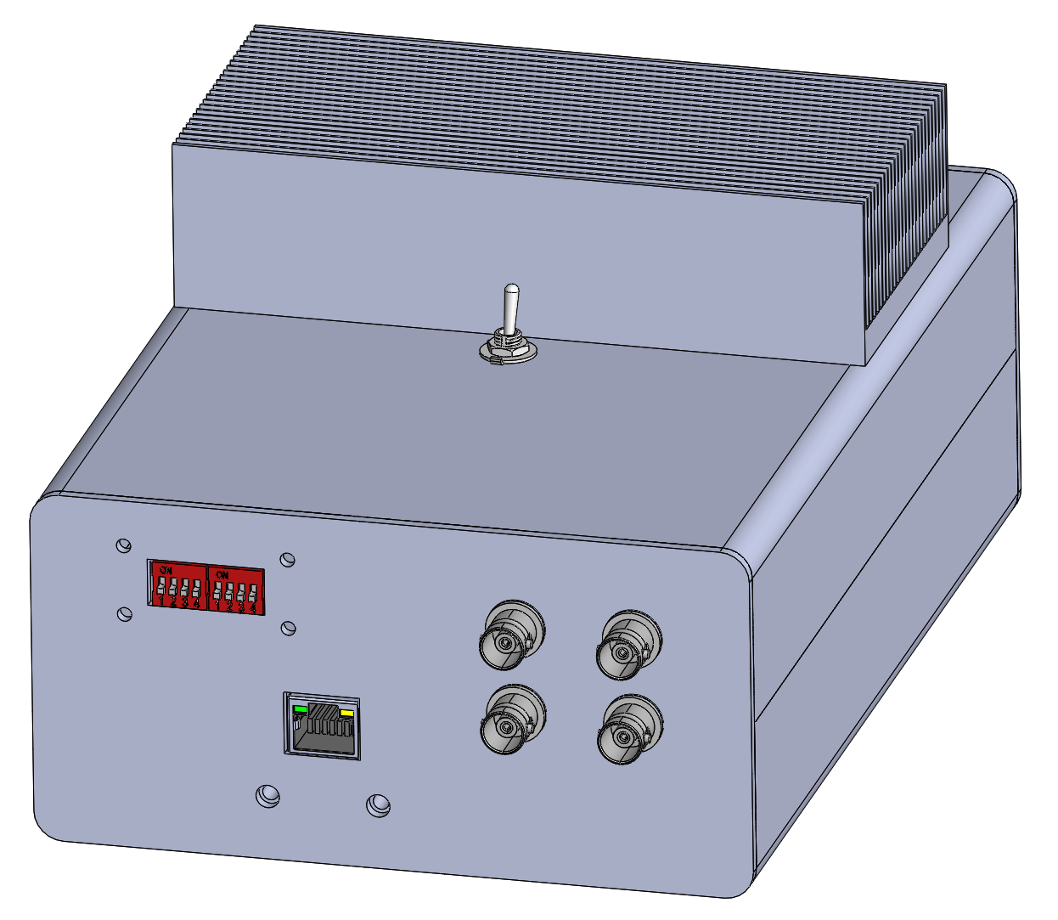
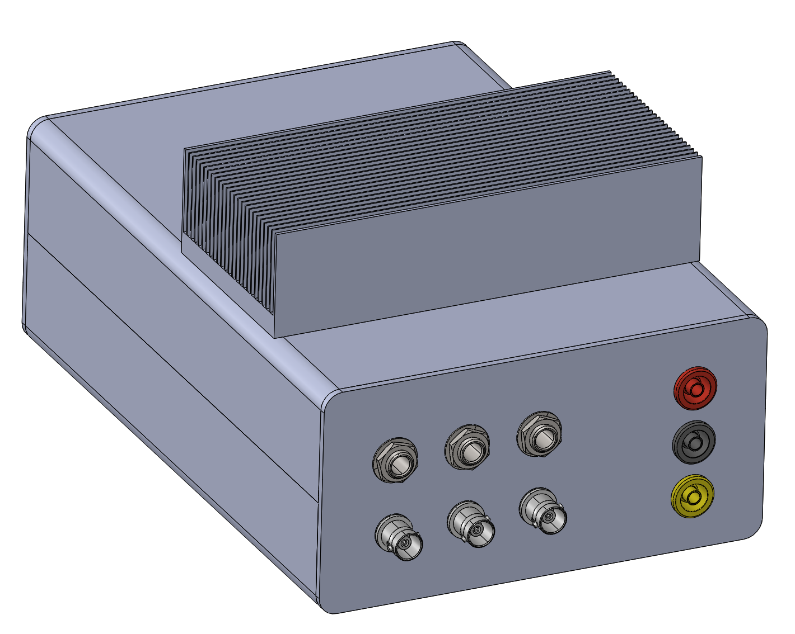
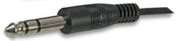
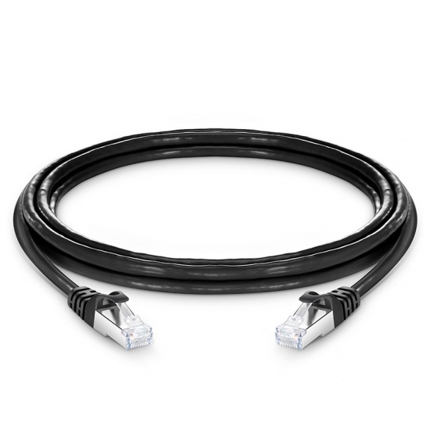
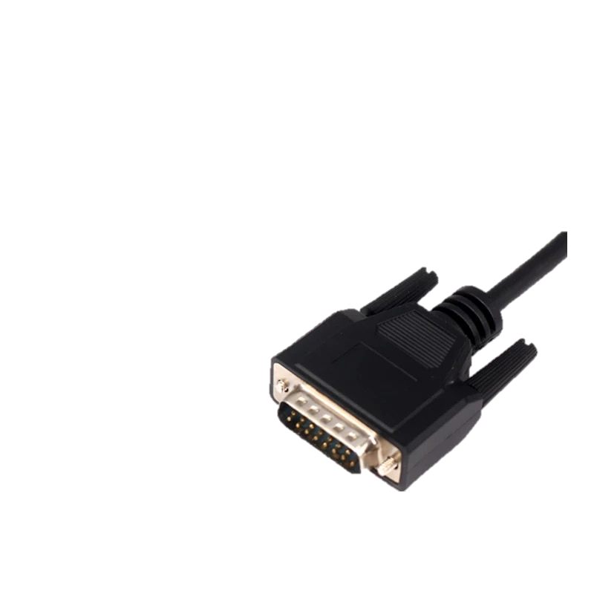
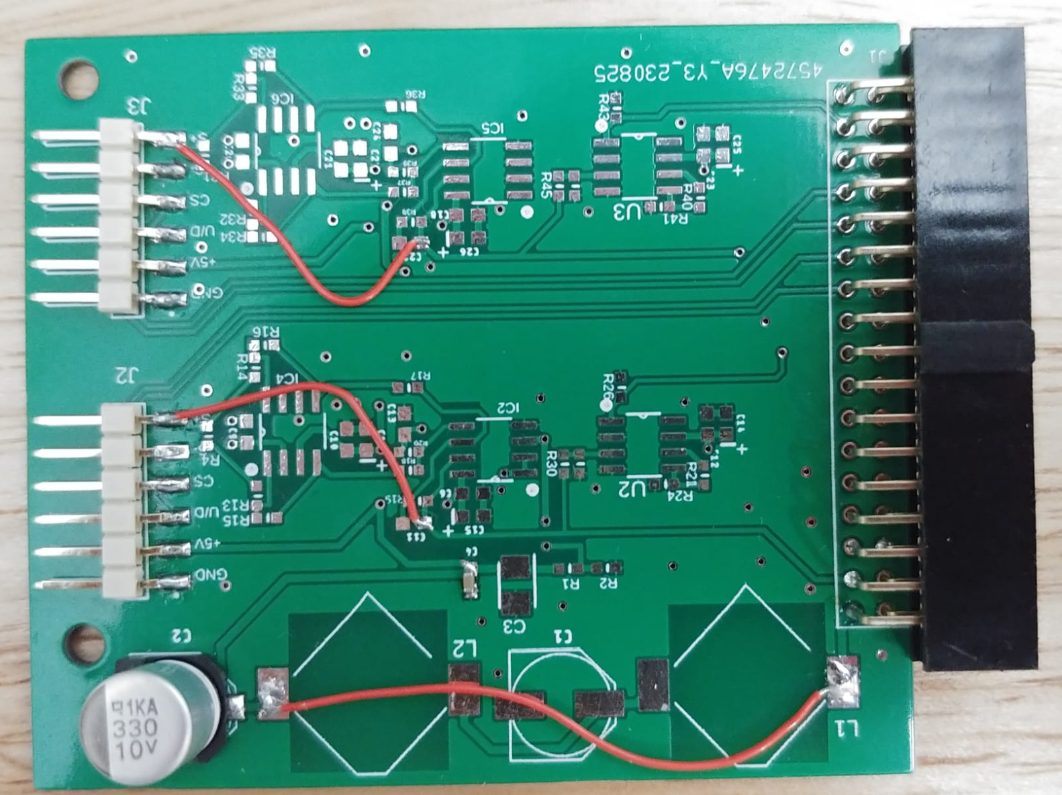
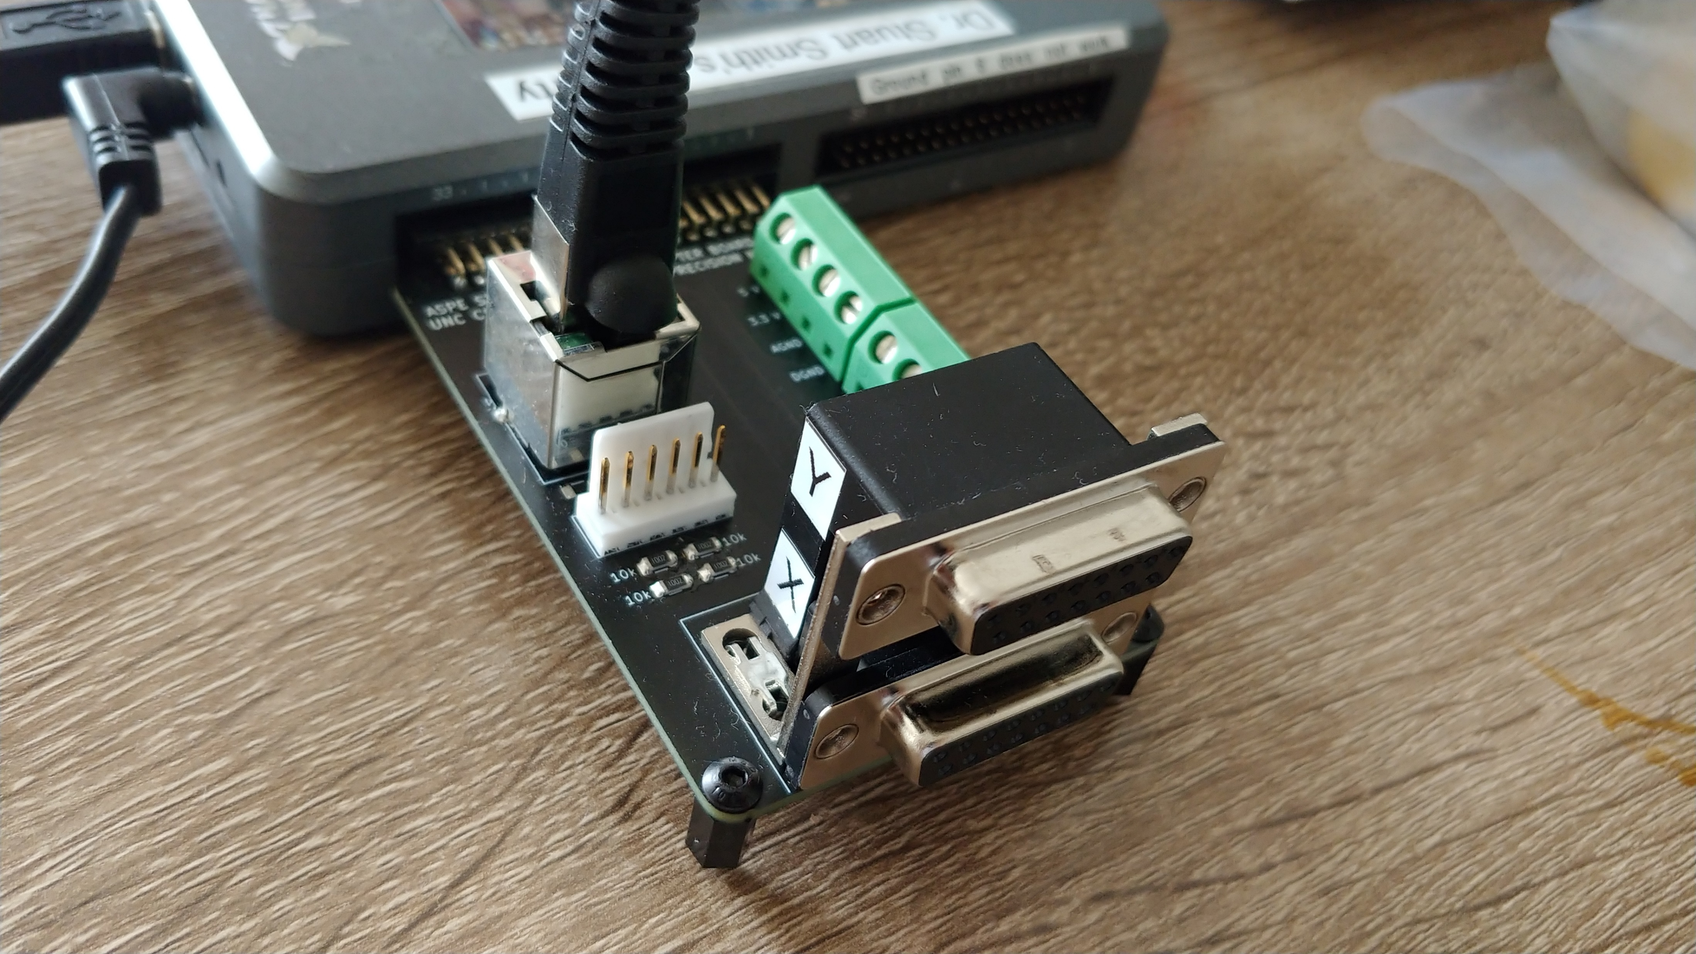
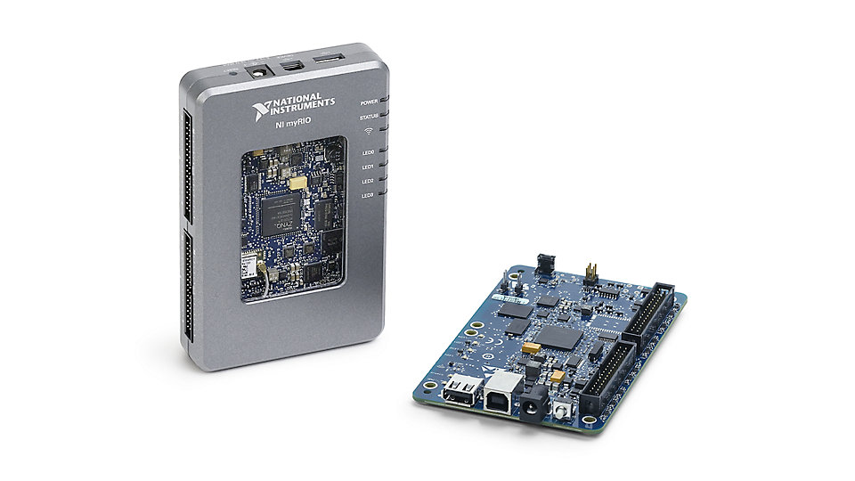
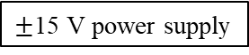
Lion precision capacitance gage
Hardware communication
Stage voice coil voice coil Jack plugs connects to AMP 1
$±$15 V power supply
BNC cable connects to ADC 1 of the DAQ unit
B
DAQ/AMP unit
PCB for the photodetectors
Shielded ethernet cable
Optical limit switches from the stage connects to 6-pin Molex connector
A
NI-myRIO microcontroller
A
DB15 connector to read the air bearing stage linescale
B
PCB connector block for encoders, limit switches, and DAQ communication. Goes to connector A of myRIO

Slide 19
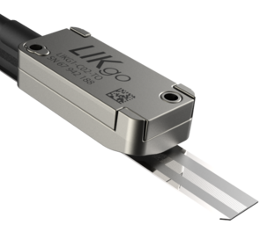
Three sensors
Interferometer
Capacitance probe
Linescale

Slide 20
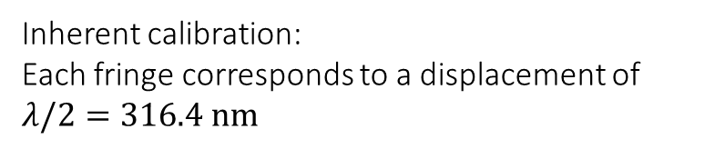

Sensor advantages
Inherent calibration:
Each fringe corresponds to a displacement of $λ/2=316.4 nm$
Interferometer
Range in meters
3 nm resolution at 0.25 mm/s
For stabilized He-Ne laser, $λ=632.8 nm$
Range
Resolution
Linescale
Capacitance probe
10 mm Range
70 nm resolution
10’s of mm/s velocity
50 µm Range
1.8 nm resolution at
15 kHz bandwidth
Speed

Slide 21

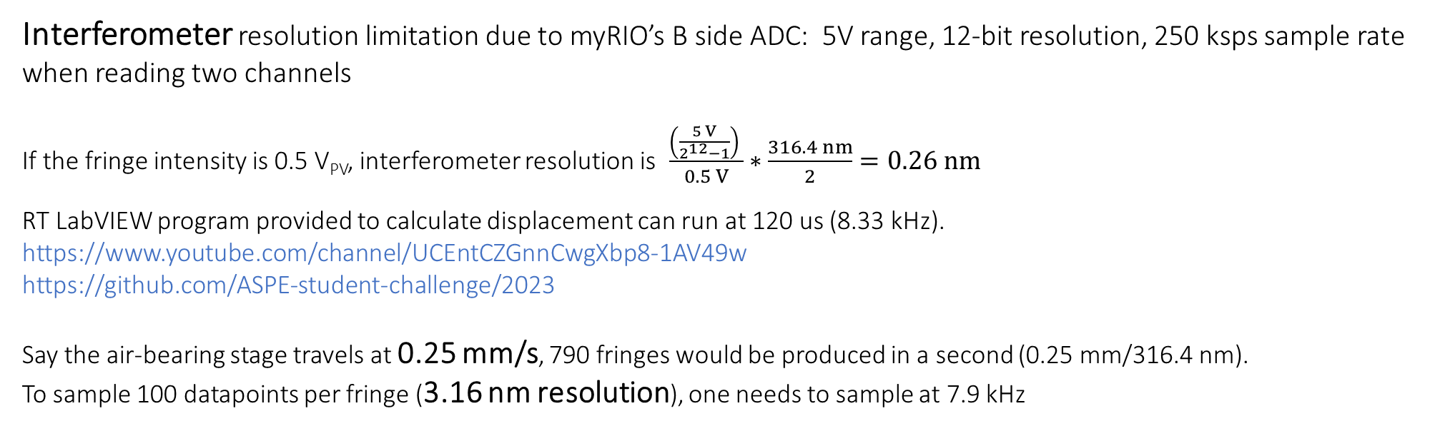
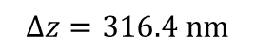
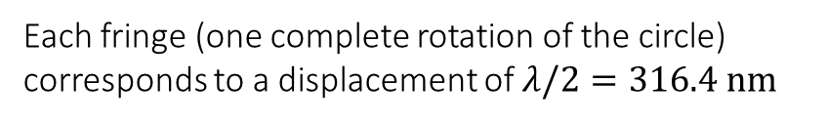
Sensing Hardware Specifications
Interferometer resolution limitation due to myRIO’s B side ADC: 5V range, 12-bit resolution, 250 ksps sample rate when reading two channels
If the fringe intensity is 0.5 V_{PV}, interferometer resolution is $\frac{\left(\frac{5 V}{2^{12}−1}\right) }{0.5 V}∗\frac{316.4 nm}{2}=0.26 nm$
RT LabVIEW program provided to calculate displacement can run at 120 us (8.33 kHz).
https://www.youtube.com/channel/UCEntCZGnnCwgXbp8-1AV49w
https://github.com/ASPE-student-challenge/2023
Say the air-bearing stage travels at 0.25 mm/s, 790 fringes would be produced in a second (0.25 mm/316.4 nm).
To sample 100 datapoints per fringe (3.16 nm resolution), one needs to sample at 7.9 kHz
$$Δz=316.4 nm$$
Each fringe (one complete rotation of the circle) corresponds to a displacement of $λ/2=316.4 nm$
V_{PV}
Intensity
Photodiode 1
Photodiode 2
For He-Ne laser, ideally $λ=632.8 nm$
Time

Slide 22
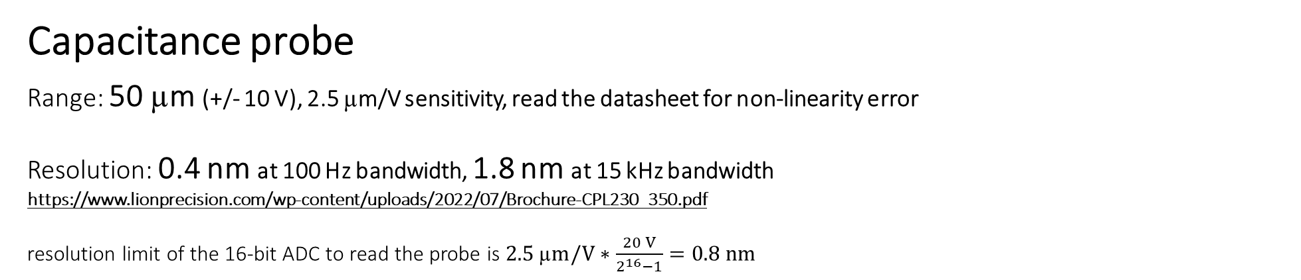
Sensing Hardware Specifications
Linescale: 70 nm resolution
LabVIEW FPGA program reads it at 8 ticks (40 MHz/8 = 5 MHz)
For example, if the air-bearing stage travels at 10 mm/s, would produce only 143k cycles of line scale output per second (10 mm/70 nm), and can be comfortably read with the 5 MHz sample rate.
Capacitance probe
Range: 50 µm (+/- 10 V), 2.5 µm/V sensitivity, read the datasheet for non-linearity error
Resolution: 0.4 nm at 100 Hz bandwidth, 1.8 nm at 15 kHz bandwidth
https://www.lionprecision.com/wp-content/uploads/2022/07/Brochure-CPL230_350.pdf
resolution limit of the 16-bit ADC to read the probe is $2.5 \text{µ}m/V∗\frac{20 V}{2^{16}−1}=0.8 nm$

Slide 23


Before the preliminary presentation on Oct 20th
Watch the YouTube videos and use the solid model assembly (Github) to assemble the interferometer.
https://www.youtube.com/playlist?list=PLy1-ZnpGPTPVfVI97nkTYyfq9PLcodRp7
https://github.com/ASPE-student-challenge/2023
Install LabVIEW (instructions at the end of the slides), use the sample project in Github. A sample program controls the stage using linescale feedback, uses interferometer to monitor the motion
Modify the LabVIEW program to feedback control the stage using the interferometer
Think about using all three sensors (interferometer, line scale, and capacitance probe) in combination for feedback, and as diagnostics
Tune the PID controller to improve the positioning performance. Lei Zhou, University of Wisconsin, Madison is expected to provide a tutorial in one of the upcoming weeks
Prepare the error budget. Stuart Smith, University of North Carolina at Charlotte is expected to provide a tutorial in one of the upcoming weeks
Post your questions on Reddit https://www.reddit.com/r/aspestudentchallenge/

Slide 24

ASK FOR HELP
aspe.challengecommittee@gmail.com

Slide 25
Deliverables for the preliminary presentation (200 points)
The meeting will be held via Zoom on Oct 20, 2023, and the schedule for each team will be emailed for their 4-minute presentation. Committee will provide live feedback and address questions of individual teams.
Teams are required to present their progress in getting the stage and interferometer operational (metrology and control efforts ) with well labelled images
10 second interferometer stability sampled at 100 Hz without air supply to stage
Report 50 nm, 5 um, 500 um, 5 mm step responses with 5 s dwell time sampled at 100 Hz using interferometer or encoder feedback. Report the reading of the sensor not used for feedback (line-scale or interferometer).
Preliminary error budget
5 s
5 mm
500 µm
5 µm
50 nm
5 s

Slide 26
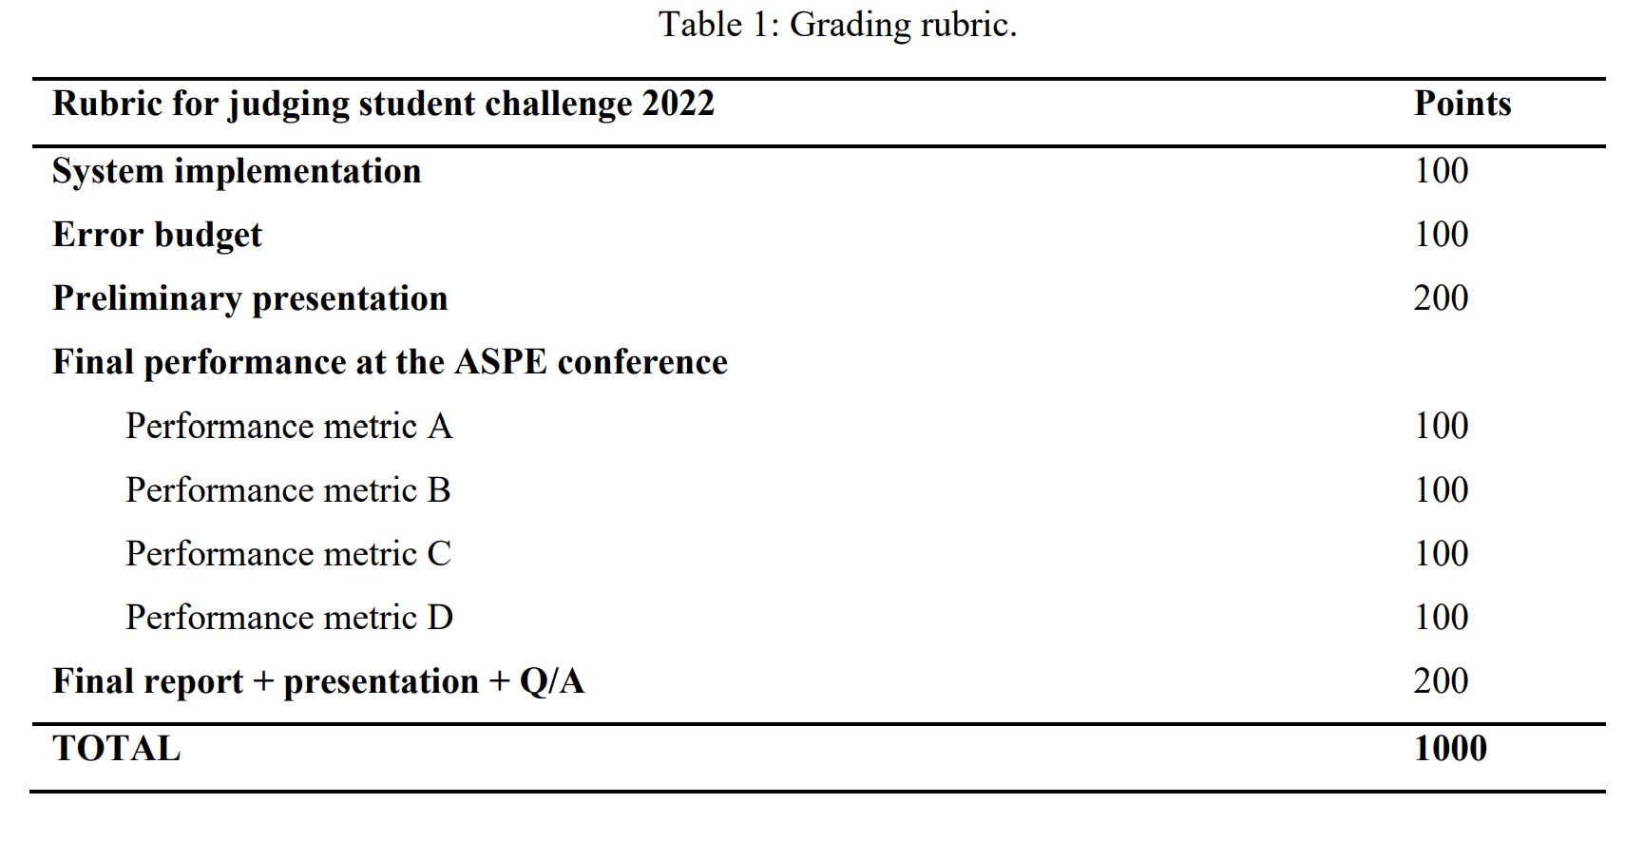
Conference deliverables
Position control the stage for a travel profile provided by the committee. Details will be revealed soon.
By Nov 5th midnight, submit a strictly two-page report (maximum of up to 4 figures) including the error budget, challenges overcame, and novel implementations.
3. You can update the error budget by Nov 13th midnight after assessing the challenge environment at the conference.
4. Presentation of metrology and control efforts, novel implementation, and Q&A.

Slide 27
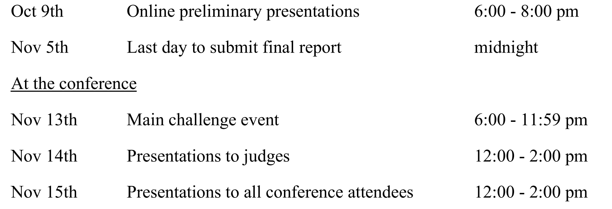
Key dates
Oct 20th

Slide 28

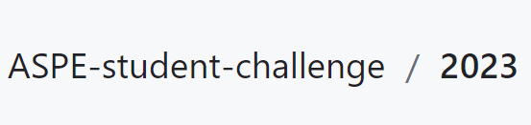
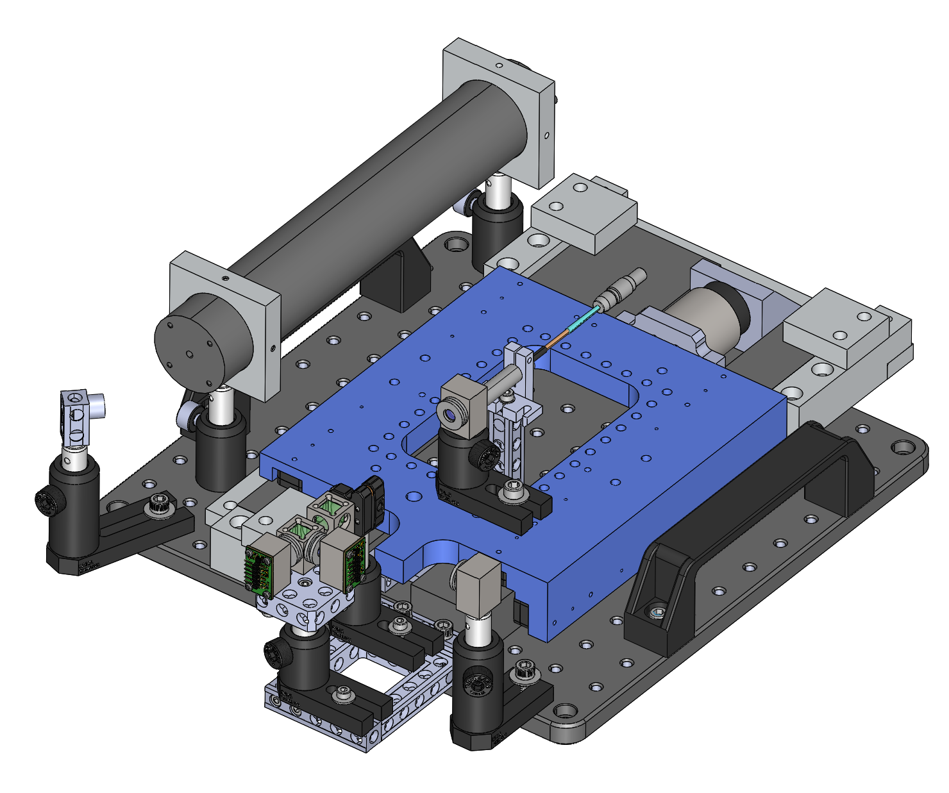
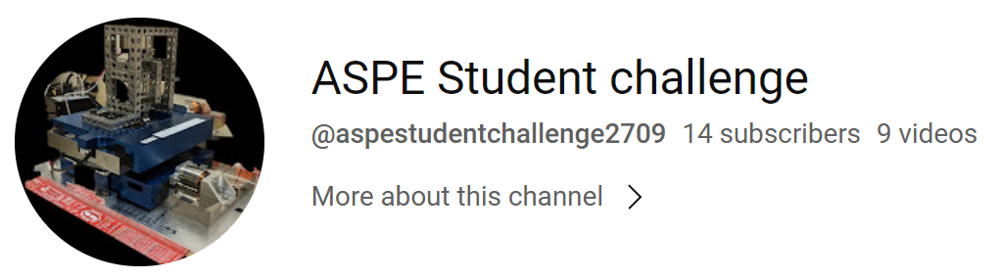
Resources
https://github.com/ASPE-student-challenge/2023
https://www.youtube.com/channel/UCEntCZGnnCwgXbp8-1AV49w
https://www.reddit.com/r/aspestudentchallenge/
aspe.challengecommittee@gmail.com

Slide 29
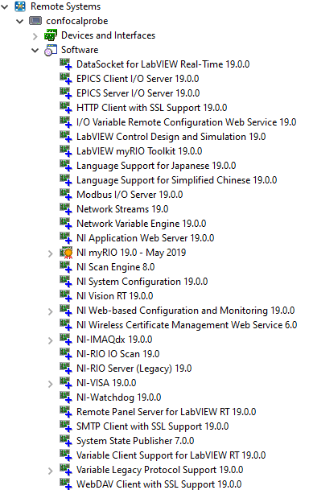
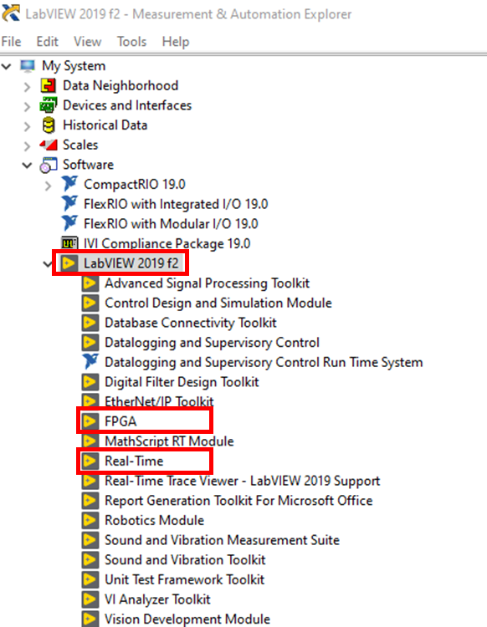
LabVIEW installation
A list of required software for myRIO can be found here, and LabVIEW myRIO software bundle contains all the required software.
To check the LabVIEW software and version installed on your PC and myRIO, open the NI MAX program on your PC. For software installed on the PC, navigate to My System > Software.
For software installed on the myRIO, ensure that the myRIO is connected to the PC, and navigate to Remote Systems > name of your myRIO > Software.
On your PC, in general
LabVIEW 2019 with FPGA and Real Time Modules
NI-RIO 19
On myRIO, in general
LabVIEW Real-Time 19.0.09
NI myRIO 19.0
Example list of NI software downloaded on the PC as shown in MAX. Indicated are the necessary modules.
List of NI software installed on the myRIO used during testing as shown in MAX. Some but possibly not all of these modules are necessary.

Slide 30
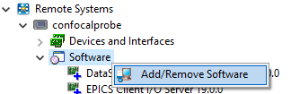
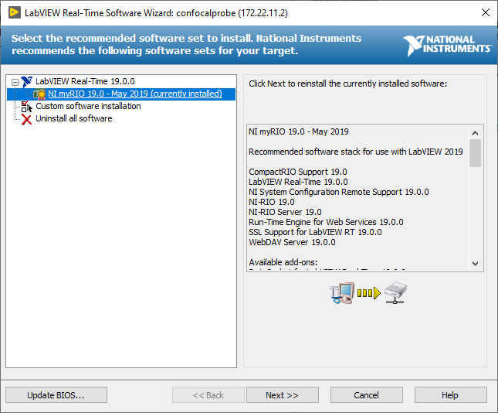
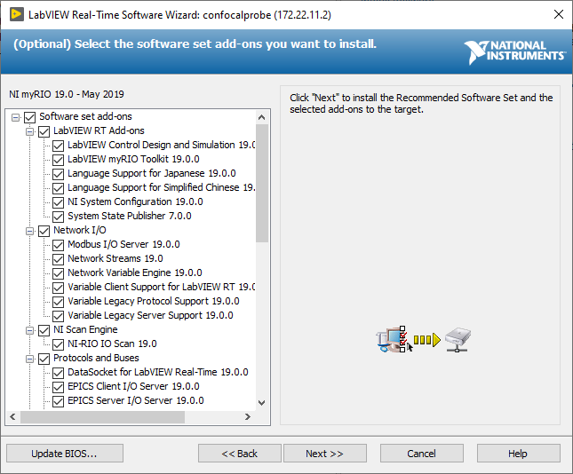
Installing software on the myRIO
Connect the myRIO to the PC. Open the NI MAX program. Navigate to Remote Systems > name of your myRIO > Software. Right click on Software and click Add/Remove Software.
Next, enter the device password for the admin user (likely blank) and select “NI myRIO 19.0” under the “LabVIEW Real-Time 19.0.0” tab. Click Next.
Click Next on the summary page and the software will be installed on the myRIO. The device may restart several times; expect the process to take several minutes.
Select all the software set add-ons, click Next.

Slide 31
Organizing committee
Luis A. Aguirre – University of Texas, Austin
Kumar Arumugam – NIST
Raymond C. Cady – Corning Inc.
Jacob Cole – IST precision
Sam Goldwasser – RepairFAQ.org
Liam G Connolly – NIST
Tim Dalrymple
Chunjie Fan – Corning Inc.
Ping Guo – Northwestern university
Mark T. Kosmowski – Electro-Scientific Industries, Inc.
Todd Noste – Lawrence Livermore national laboratory
Charles Perera – NASA, Goddard space flight center
Jesse Redford - University of North Carolina at Charlotte
Nilabh Roy – Canon Nanotechnologies
Stuart Smith – University of North Carolina at Charlotte
Lei Zhou - University of Texas, Austin
With contributions and consultant input from
Dhanooj Bobba - University of North Carolina at Charlotte
Tyler Hamer – MIT Lincoln laboratory
Hilary Johnson – Lawrence Livermore national laboratory
Sam Ludwig– Lawrence Livermore national laboratory
Thapelo Mametja - National Metrology Institute of South Africa
Parth Pandya - University of Texas, Austin
Kent Queensland – Lion precision
Senajith Bandara Rekawa – Lawrence Berkeley Laboratories

